Slide 1
What is Reconfigurable Computing?
  Computation using hardware that can adapt at the logic level to solve specific problems
Why is this interesting?
  Many applications are poorly suited to microprocessors
  VLSI “explosion” provides increasing resources. How can we use them?
    “field-programmable” devices
  Allows for high performance, bug fixes, and fast time-to market for a selection of applications

Slide 2
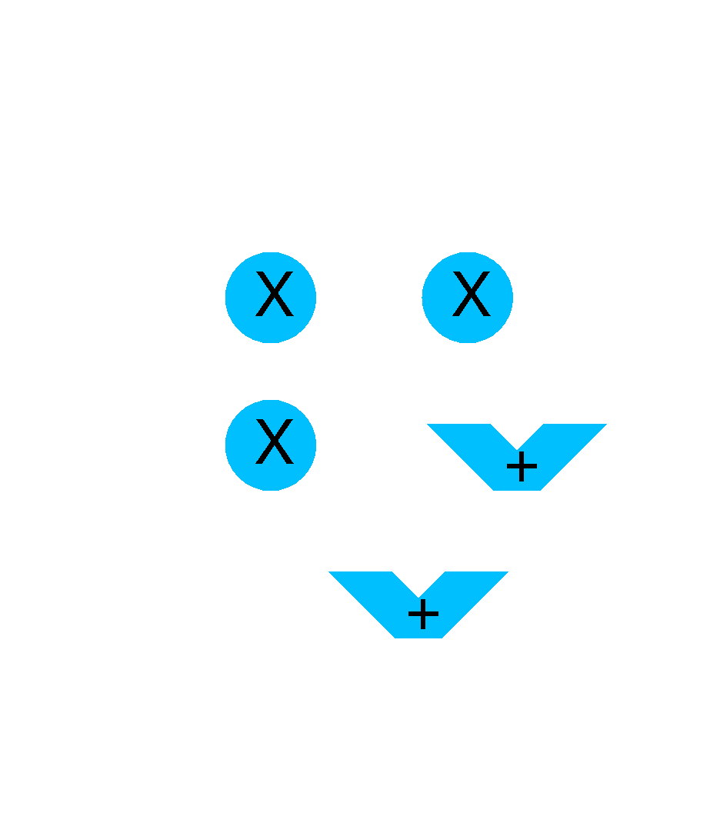
What characterizes Reconfigurable Computing?
Parallelism, specialization, hardware-level adaptation
Parallelism customized to meet design objectives
Logic specialized to perform specific function
Functionality changed as problem requirements change

Slide 3
Microprocessor-based Systems (Temporal)
Data Storage
(Register File)
A
B
C
ALU
64
  Generalized to perform many functions well.
  Operates on fixed data sizes.
  Inherently sequential
    Constrained even with multiple data paths.

Slide 4
Reconfigurable Computing
if (A > B) {
H = A;
L = B;
}
else {
H = B;
L = A;
}
A
B
Functional
Unit
H
L
  Create specialized hardware for each application.
  Functional units optimized to perform a special task.

Slide 5
Example: Bubblesort (Spatial)
A
B
A
B
H
L
H
L
A
B
A
B
H
L
H
L
A
B
H
L
Smallest
Largest
  Adapt interconnect to problem.
  Take advantage of parallelism.

Slide 6
Implementation Spectrum
Microprocessor
Reconfigurable
Hardware
ASIC
  ASIC gives high performance at cost of inflexibility.
  Processor is very flexible but not tuned to the application.
  Reconfigurable hardware is a nice compromise.

Slide 7
Implementation Spectrum: ASIC VS FPGA
A Field Programmable Gate Array can be seen as the prototyping stage of Application Specific Integrated Circuits: ASICs are very expensive to manufacture, and once it's made there is no going back (as the most expensive fixed cost is the masks [sort of manufacturing "stencil"] and their development). FPGAs are reprogrammable many times, however because of the fact that a generic array of gates is connected to accomplish your goal, it is not optimised like ASICs. Also, FPGAs are natively dynamic devices in that if you power it off, you loose not only the current state but also your configuration. Boards now exist though that add a FLASH chip and/or a microcontroller to load the configuration at startup so this tends to be a less important argument. Both ASICs and FPGAs can be configured with Hardware Description Languages, and sometimes FPGAs are used for the end product. But generally ASICs kick in when the design is fixed.

Slide 8
Implementation Spectrum: FPGA vs microcontroller
As for the difference between a microcontroller and a FPGA, you can consider a microcontroller to be an ASIC which basically processes code in FLASH/ROM sequentially. You can make microcontrollers with FPGAs even if it's not optimised, but not the opposite. FPGAs are wired just like electronic circuits so you can have truly parallel circuits, not like in a microcontroller where the processor jumps from a piece of code to another to simulate good-enough parallelism. However because FPGAs have been designed for parallel tasks, it's not as easy to write sequential code as in a microcontroller.
For example, typically if you write in pseudocode "let C be A XOR B", on a FPGA that will be translated into "build a XOR gate with the lego bricks contained (lookup tables and latches), and connect A/B as inputs and C as output" which will be updated every clock cycle regardless of whether C is used or not. Whereas on a microcontroller that will be translated into "read instruction - it's a XOR of variables at address A and address B of RAM, result to store at address C. Load arithmetic logic units registers, then ask the ALU to do a XOR, then copy the output register at address C of RAM". On the user side though, both instructions were 1 line of code. If we were to do this, THEN something else, in HDL we would have to define what is called a Process to artificially do sequences - separate from the parallel code. Whereas in a microcontroller there is nothing to do. On the other hand, to get "parallelism" (tuning in and out really) out of a microcontroller, you would need to juggle with threads which is not trivial. Different ways of working, different purposes.

Slide 9
Implementation Spectrum: FPGA vs ASIC vs microcontroller
In summary:
ASIC VS FPGA: fixed, more expensive for small number of products (cheaper for high volumes),
but more optimised.
ASIC VS microcontroller: certainly like comparing a tool with a hammer.
FPGA VS microcontroller: not optimised for sequential code processing, but can do truly parallel tasks very easily
as well.
Generally FPGAs are programmed in HDL, microcontrollers in C/Assembly
Whenever speed of parallel tasks is an issue, take an FPGA, evolve your design and finally make it an ASIC if it's cheaper to you in the long run (mass production). If sequential tasks are okay, take a microcontroller. I guess you could do an even more application specific IC from this if it's cheaper to you in the long run as well. The best solution will probably be a bit of both.

Slide 10
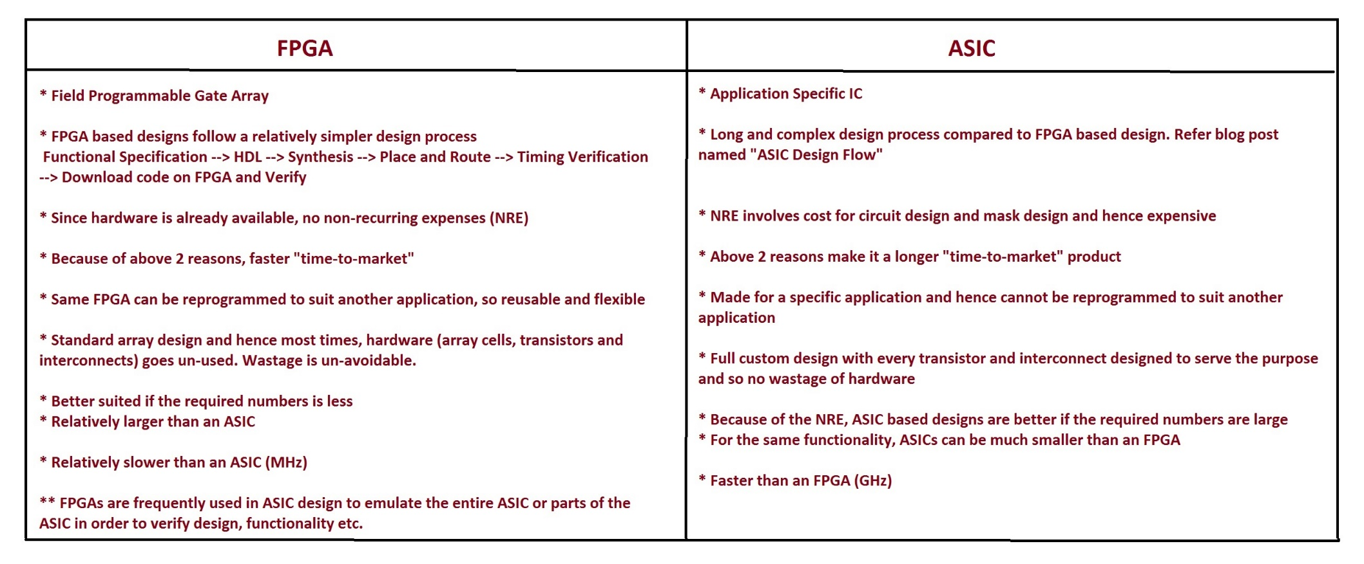
Implementation Spectrum

Slide 11
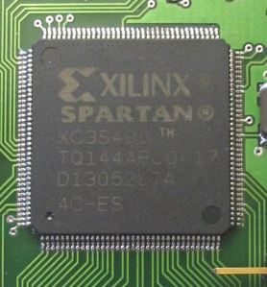
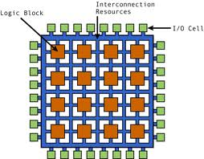
Motivation: What is an FPGA?
A Field Programmable Gate Array (FPGA) is a Programmable Logic Device(PLD) with higher densities and capable of implementing different functions in a short period of time.

Slide 12
Motivation: What is an FPGA?
2-D array of logic blocks and flip-flops with programmable interconnections.
Compact design
User can configure
  Intersections between
the logic blocks
  The function of each block
Configurable
Logic
Blocks
Block RAMs
Block RAMs
I/O
Blocks
Block
RAMs

Slide 13
Motivation: FPGA vs ASIC vs Microcontroller
ASIC VS FPGA: fixed, more expensive for small number of products (cheaper for high volumes), but more optimized.
ASIC VS microcontroller: certainly like comparing a tool with a hammer.
FPGA VS microcontroller: not optimized for sequential code processing, but can do truly parallel tasks very easily as well.
FPGAs =>HDL & Microcontrollers => Assembly/ C (Even in Java/ Python now)
Parallel tasks => FPGA, finally ASIC (mass production).
Sequential tasks => Microcontrollers

Slide 14
Motivation: General structure of an FPGA

Slide 15
Motivation: Xilinx Spartan 3 FPGAs

Slide 16
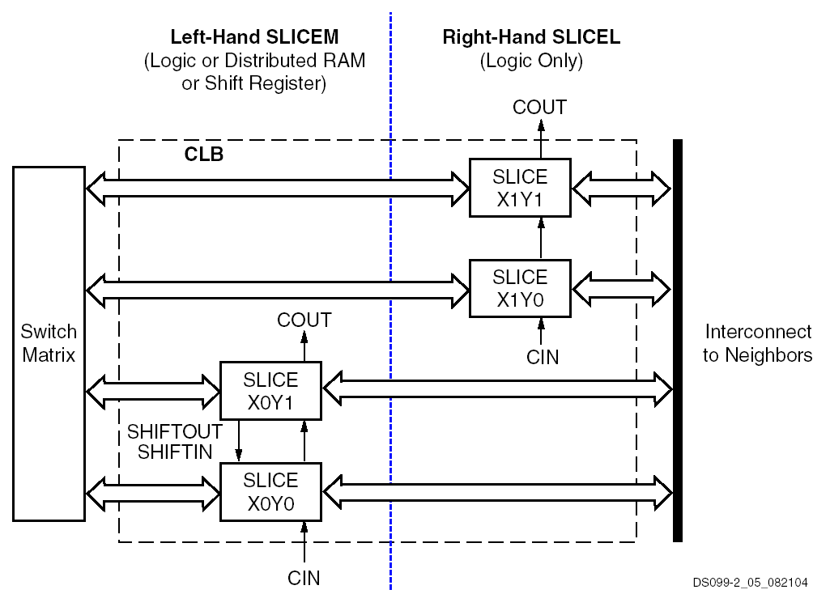
Motivation: CLB Structure
Notes:
The configurable logic block (CLB) contains two slices. Each slice contains two 4-input look-up tables (LUT), carry & control logic and two registers. There are two 3-state buffers associated with each CLB, that can be accessed by all the outputs of a CLB.
Xilinx is the only major FPGA vendor that provides dedicated resources for on-chip 3-state bussing. This feature can increase the performance and lower the CLB utilization for wide multiplex functions. The Xilinx internal bus can also be extended off chip.

Slide 17
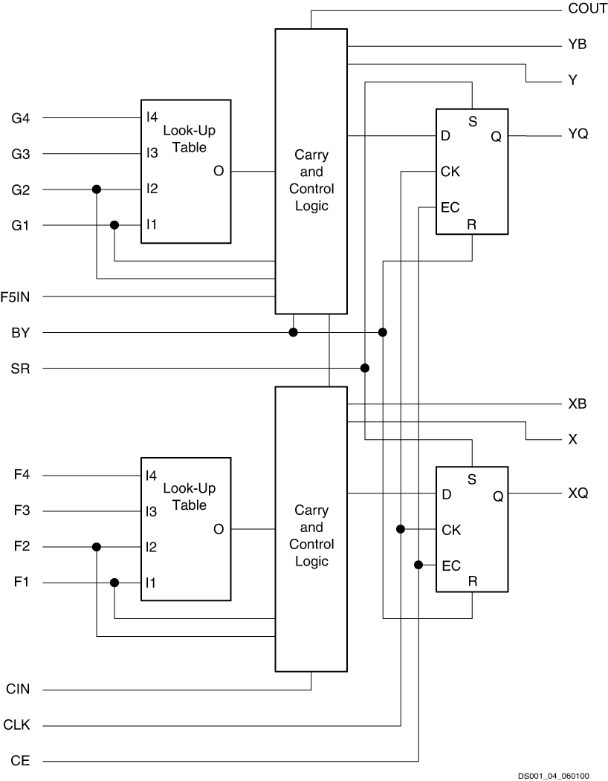
Motivation: CLB Slice Structure
Each slice contains two sets of the following:
  Four-input LUT
    Any 4-input logic function,
    or 16-bit x 1 sync RAM (SLICEM only)
    or 16-bit shift register (SLICEM only)
  Carry & Control
    Fast arithmetic logic
    Multiplier logic
    Multiplexer logic
  Storage element
    Latch or flip-flop
    Set and reset
    True or inverted inputs
    Sync. or async. control
Notes:
The configurable logic block (CLB) contains two slices. Each slice contains two 4-input look-up tables (LUT), carry & control logic and two registers. There are two 3-state buffers associated with each CLB, that can be accessed by all the outputs of a CLB.
Xilinx is the only major FPGA vendor that provides dedicated resources for on-chip 3-state bussing. This feature can increase the performance and lower the CLB utilization for wide multiplex functions. The Xilinx internal bus can also be extended off chip.

Slide 18
Motivation: LUT (Look-Up Table) Functionality
Look-Up tables are primary elements for logic implementation
Each LUT can implement any function of
4 inputs
Notes:
A look up table (LUT) is a memory with a one-bit output
that essentially implements a truth table where each input combination generates a certain logic
output. The input combination is referred to as an address. The HDL synthesizer implements an
AND gate or other simple logic function by programming the stored elements in a LUT.

Slide 19
VHDL
opcode {+, -, AND, OR}
A
ALU
X
B
Behavior VHDL: ALU
compnt ALU (A,B,opcode,X)
case opcode
when => opPlus
X <= A + B;
when => opSub
X <= A – B;
when => opAND
X <= A and B;
when => opOR
X <= A or B;
end case;
end component;
Structural VHDL: ALU
component ALU (A,B,
opcode, X)
addAB(A,B,Xadd);
subAB(A,B,Xsub);
andAB(A,B,Xand);
orAB(A,B,Xor);
4:1mux(opcode,
Xadd,Xor,
Xand,Xor,X);
end component;

Slide 20
VHDL
opcode {+, -, AND, OR}
A
ALU
X
B
opcode {+, -, AND, OR}
ALU
Xadd
2
Structural VHDL: ALU
component ALU (A,B,
opcode, X)
addAB(A,B,Xadd);
subAB(A,B,Xsub);
andAB(A,B,Xand);
orAB(A,B,Xor);
4:1mux(opcode,
Xadd,Xor,
Xand,Xor,X);
end component;
addAB
4:1
Mux
A
subAB
Xsub
X
andAB
Xand
B
orAB
Xor

Slide 21
Computation Models
Abstraction that allows
  Reasoning about computation
    Correctness
    Extraction of parallelism
  Transformations for optimization
  Guarantee Properties
Memory
FPGA
CPU

Slide 22
Computation Models
Abstraction that allows
  Reasoning about computation
    Correctness
    Extraction of parallelism
  Transformations for optimization
  Guarantee Properties
Memory
Function
2
Function
1
Function
4
Function
3

Slide 23
Computation Models
Abstraction that allows
  Reasoning about computation
    Correctness
    Extraction of parallelism
  Transformations for optimization
  Guarantee Properties
Memory
Function
1
Memory
Function
2
Function
5
Memory
Function
3
Memory
Function
4
Memory

Slide 24
Mapping Logics to FPGAs
X <= A+B;
X <= A xor B;
X <= A and B;
X <= A or B;
A
addAB
X
A
xorAB
X
A
andAB
X
A
orAB
X
B
B
B
B
A B X
A B X
A B X
A B X
0 0
0 1
1 0
1 1
0 0
0 1
1 0
1 1
0 0
0 1
1 0
1 1
0 0
0 1
1 0
1 1
0
1
1
1
0
1
1
0
0
1
1
0
0
0
0
1
2-input Look Up Tables (LUTs)
FPGA
LUT
LUT
LUT
LUT
LUT
LUT
LUT
LUT
LUT
LUT
LUT
LUT
LUT
LUT
LUT
LUT

Slide 25
Mapping Logics to FPGAs
X <= A+B;
X <= A xor B;
X <= A and B;
X <= A or B;
A
addAB
X
A
xorAB
X
A
andAB
X
A
orAB
X
B
B
B
B
A B X
A B X
A B X
A B X
0 0
0 1
1 0
1 1
0 0
0 1
1 0
1 1
0 0
0 1
1 0
1 1
0 0
0 1
1 0
1 1
0
1
1
1
0
1
1
0
0
1
1
0
0
0
0
1
2-input Look Up Tables (LUTs)
FPGA
LUT
addAB
LUT
LUT
LUT
LUT
LUT
xorAB
andAB
LUT
LUT
LUT
LUT
orAB
LUT
LUT

Slide 26
Reconfigurable Hardware
Look-up table (LUT)
A
B
Out
C
D
A B C D = out
  Each LUT operates on four one-bit inputs.
  Output is one data bit.
  Can perform any boolean function of four inputs
  2 = 64K functions (4096 patterns)
4
2

Slide 27
Logic Element

Slide 28
Field-Programmable Gate Array
Logic Element
Tracks
LE
LE
LE
LE
LE
LE
LE
LE
LE
LE
LE
LE
  Each logic element outputs one data bit.
  Interconnect programmable between elements.
  Interconnect tracks grouped into channels.

Slide 29
FPGA Architecture Issues
Logic
Element
  Need to explore architectural issues.
  How much functionality should go in a logic element?
  How many routing tracks per channel?
  Switch “population”?

Slide 30
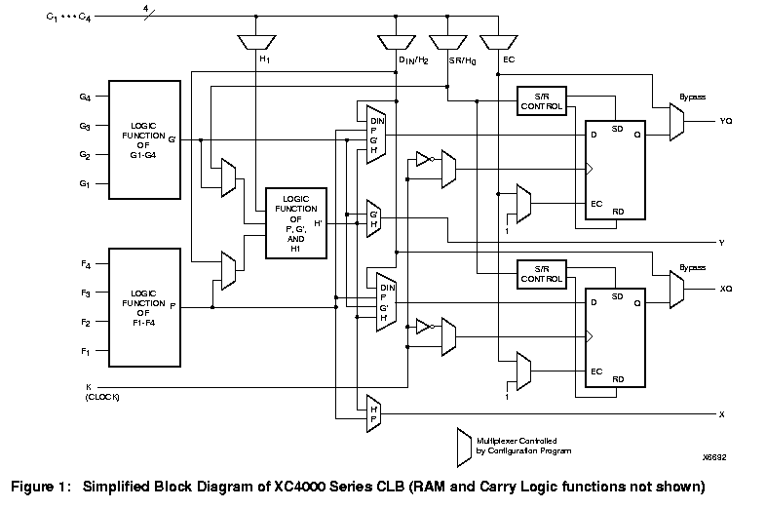
In the Beginning - Xilinx XC4000 Cell
  2 4-input look-up tables
  1 3-input look-up table
  2 D flip flops

Slide 31
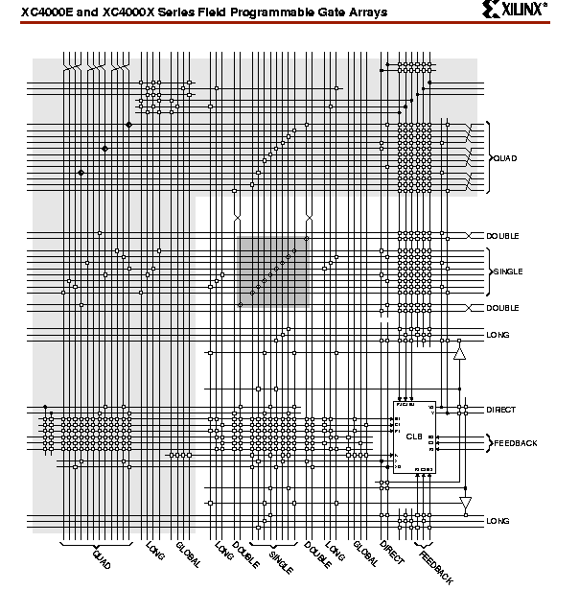
In the Beginning - Xilinx XC4000 Routing
25

Slide 32
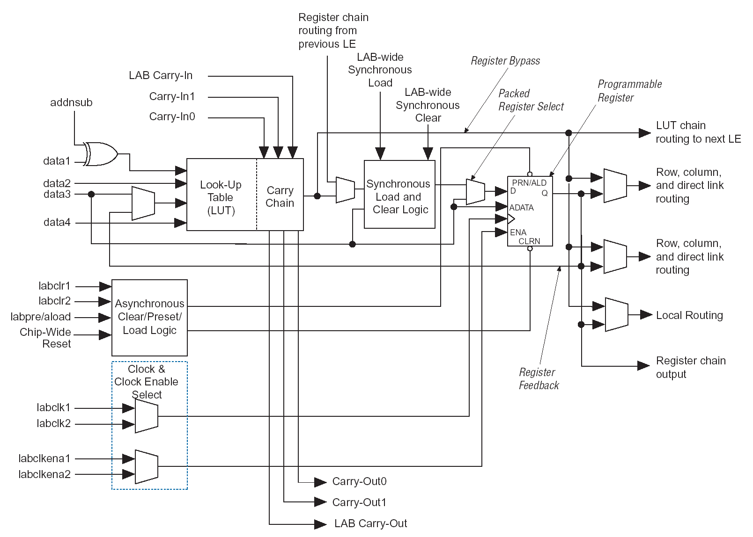
Altera Stratix Logic Element

Slide 33
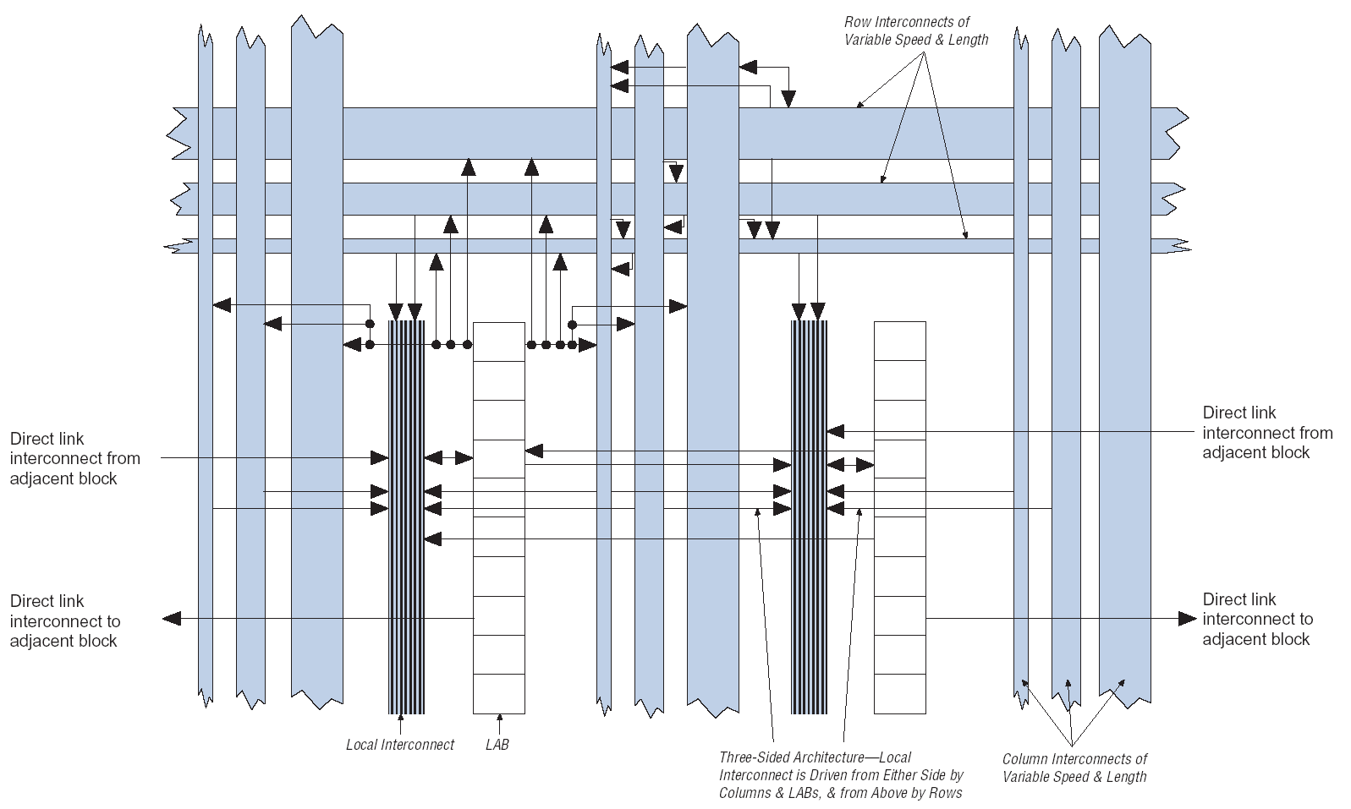
Altera Stratix Logic Array Blocks (Clusters)

Slide 34
Design abstractions
English
specification
Executable
program
Throughput,
design time
behavior
Function units,
clock cycles
function
Sequential
machines
register-
transfer
Spec.
level
Literals,
logic depth
logic
Logic gates
transistors
circuit
nanoseconds
rectangles
layout
microns

Slide 35
High-level Compilers
  Difficult to estimate hardware resources.
  Some parts of program more appropriate for processor (hardware/software codesign).
  Compiler must parallelize computation across many resources.
  Engineers like to write in C rather than pushing little blocks around.
for (i = 0; i<n, i++)
{
c[i] = a[i] + b[i]
}
Some success stories

Slide 36
Translating a Design to an FPGA
RTL
.
.
C = A+B
.
Circuit
Array
A
+
C
B
  CAD to translate circuit from text description to physical implementation well understood.
  Most current FPGA designers use register-transfer level specification (allocation and scheduling)
  Same basic steps as ASIC design.

Slide 37
Circuit Compilation
Technology Mapping
Placement
Routing
LUT
LUT
?
Assign a logical LUT to a physical location.
Select wire segments
And switches for
Interconnection.

Slide 38
Technology Mapping: A Simple Example
Made of Full Adders
A
B
A+B = D
C_{o}
FA
C_{i}
S
Logic synthesis tool reduces circuit to
SOP form
S = ABC_{i} + ABC_{i} + ABC_{i} + ABC_{i}
A
A
B
LUT
C_{o}
B
LUT
S
C_{i}
C_{i}
C_{o} = ABC_{i} + ABC_{i} + ABC_{i} + ABC_{i}

Slide 39
Processor + FPGA
Three possibilities
daughtercard
Proc
FPGA
chip
Backplane bus
(e.g. PCI)
1. FPGA serves as coprocessor for data
intensive applications – possible project.
Proc
FPGA
chip
2. FPGA serves as embedded computer
for low latency transfer.
“Reconfigurable Functional Unit”

Slide 40
Processor + FPGA (cont..)
3. Processor integration
Processor
RF
ALU
FPGA
  FPGA logic embedded inside processor.
  A number of problems with 2 and 3.
    Process technology an issue.
    ALU much faster than FPGA generally.
    FPGA much faster than the entire processor.

Slide 41
Programmable System on a Chip
Specialized hardware is commonly used for compute-intensive applications
  Coprocessors (FPU, graphics, sound, …)
  Accelerator boards (FPGA boards, I/O cards, …)
FPGAs also perform well for many of these apps
Reconfigurable logic in System-On-A-Chip
RAM
FPGA
Custom
Logic
DSP
RAM
Custom Logic
CPU
DSP
CPU
Analog
FPGA

Slide 42
Dynamic Reconfiguration
L
L
L
L
  What if I want to exchange part of the design in the device with another piece?
  Need to create architectures and software to incrementally change designs.
  Effectively a “configuration cache”
  Examples: encryption, filtering.

Slide 43
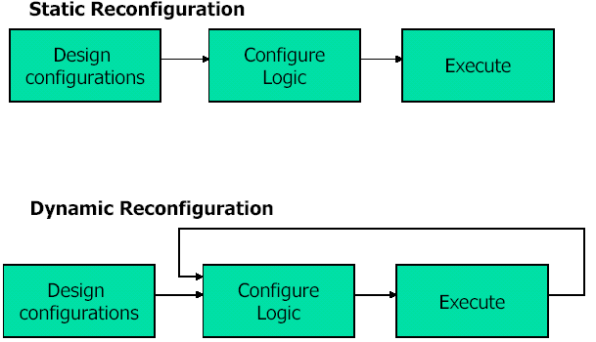
Classifying Reconfiguration
Reconfiguration methodology
Static
Partially static (=partial reconfiguration)
Dynamic

Slide 44
Types of Reconfiguration
Types of reconfiguration
  Static reconfiguration – application is not running
  Semi-static – different portions of application time-sliced on same hardware fabric
  Dynamic reconfiguration – application modified in response to changing environmental issues
What is reconfigured?
  Processor reconfiguration – customized instruction sets, pipelining, bit width
  Parameter reconfiguration
  Control reconfiguration
Can you think of other applications?

